Slide 1

Database Management Systems 19CS2108

Slide 2
Session Outcomes
Comprehend the basic terminology related to data & databases
Appreciate various approaches of storing data

Slide 3
Basic Terminology
Data: Known facts that can be recorded and have an implicit meaning.
Structured: numbers, text, dates
Unstructured: images, video, documents
Information: giving facts a shape
Knowledge: understanding the facts
Wisdom: applying knowledge to given situation
Metadata: data that describes the properties and context of user data

Slide 4
Basic Terminology
Database: An organized collection of related data.
Mini-world: Some part of the real world about which data is stored in a database. For example, student grades and transcripts at a university.
Database Management System (DBMS): A software package/ system to facilitate the creation and maintenance of a computerized database.
Database System: The DBMS software together with the data itself. Sometimes, the applications are also included.

Slide 5
Approaches to store data
•There are two approaches for storing data in computers:
File-based approach.
Database-approach.

Slide 6
Difference Between File and Database approach

Slide 7
File Based Approach
A filesystem is a method for storing and organizing computer files and the data they contain to make it easy to find and access them.
File systems may use a storage device such as a hard disk or CD ROM and involve maintaining the physical location of the files.
Programmers used programming languages such as COBOL, C++ to write applications that directly accessed files to perform data management services and provide information for users.

Slide 8
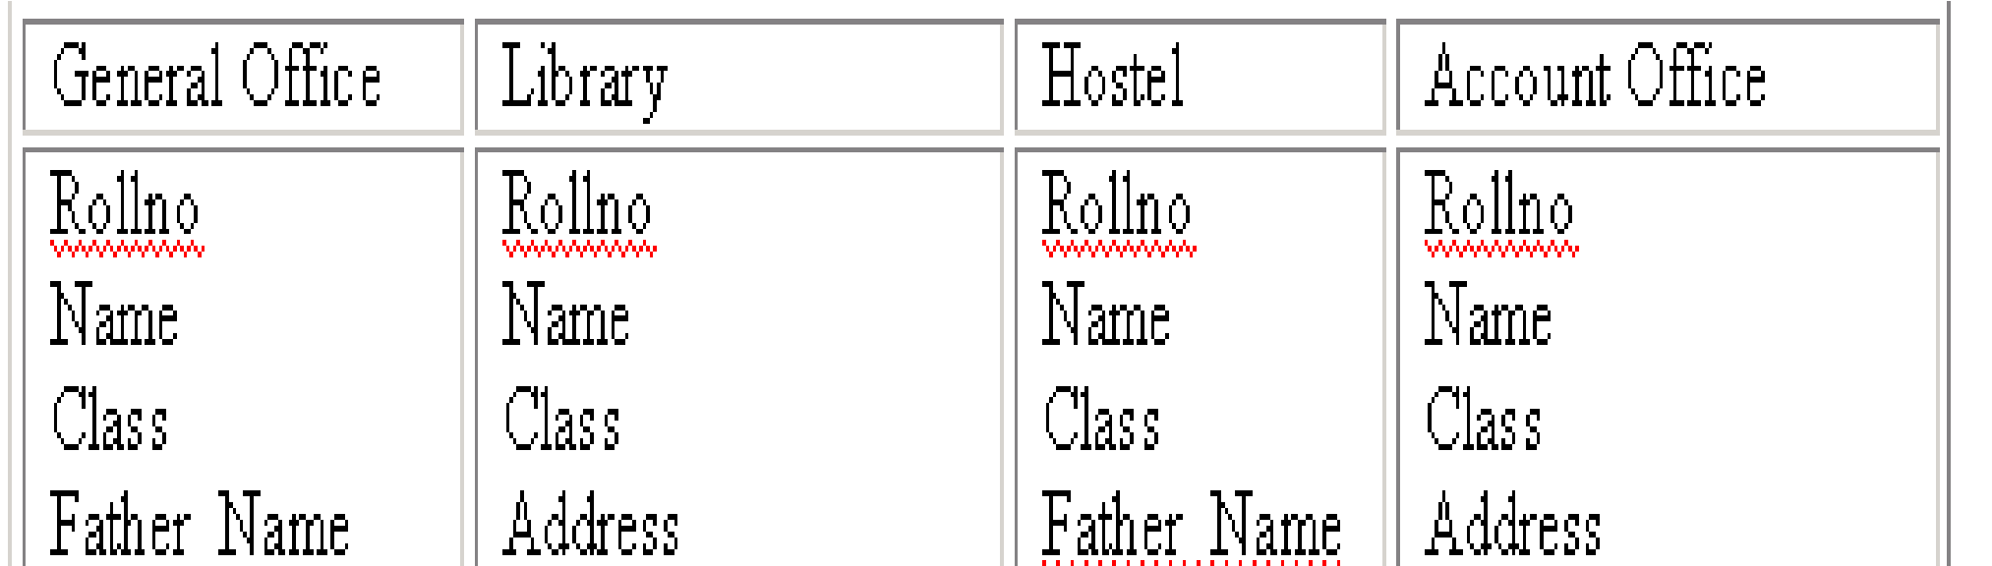
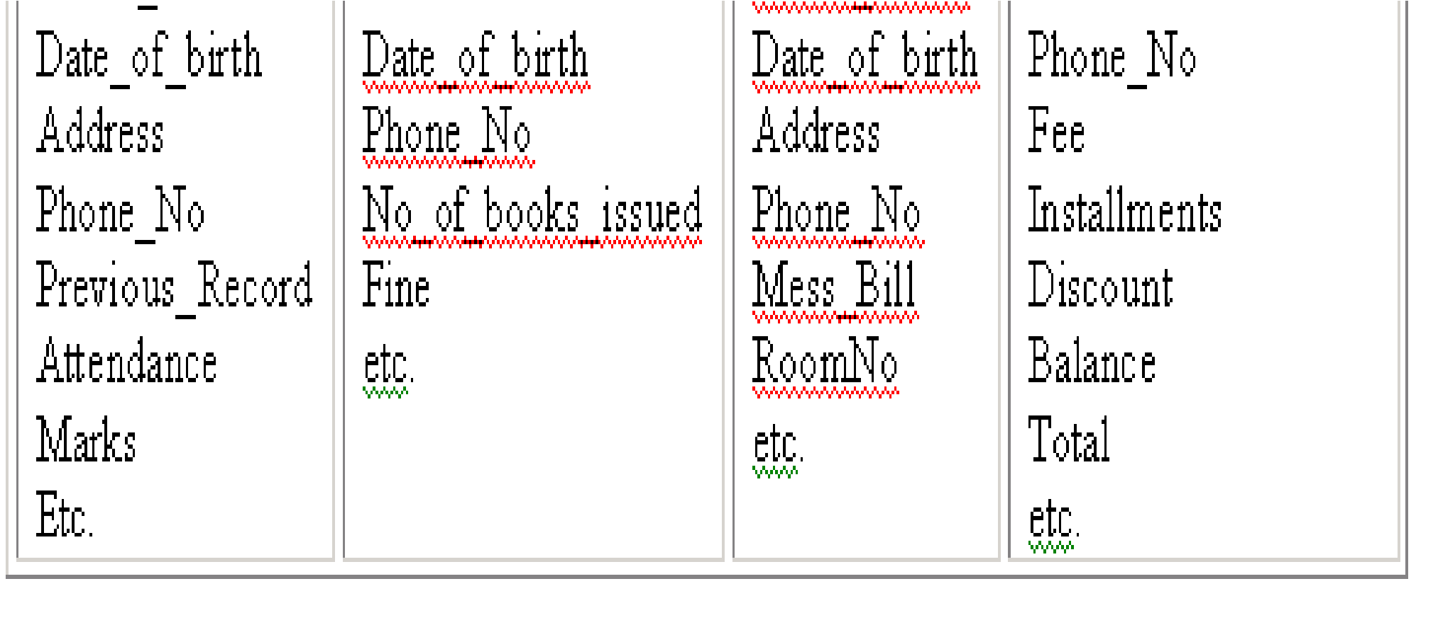
University Database in File Based System

Slide 9
Problems in traditional approach
Data Redundancy
Data Security
Data Isolation
Program / Data Dependence
Lack of Flexibility
Concurrent Access Anomalies
Data isolation is a property that determines when and how changes made by one operation become visible to other concurrent users and systems. This issue occurs in a concurrency situation.
Notes:
Data isolation is a property that determines when and how changes made by one operation become visible to other concurrent users and systems. This issue occurs in a concurrency situation.

Slide 10
Advantages in traditional approach
Easy to understand
Easy to implement
Easy to extract information
All records stored in one place
Simple sorting and filtering of reports
Less hardware and software requirements
Notes:
Data isolation is a property that determines when and how changes made by one operation become visible to other concurrent users and systems. This issue occurs in a concurrency situation.

Slide 11
Database Approach
The database is a single, large repository of data, which can be used simultaneously by many departments and users.

Slide 12
History of Database Systems
1950s and early 1960s:
Data processing using magnetic tapes for storage
Tapes provide only sequential access
Punched cards for input

Slide 13
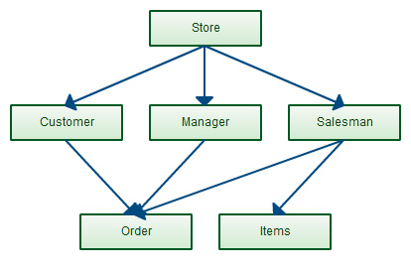
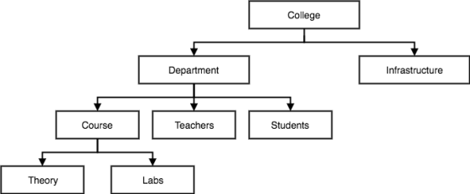
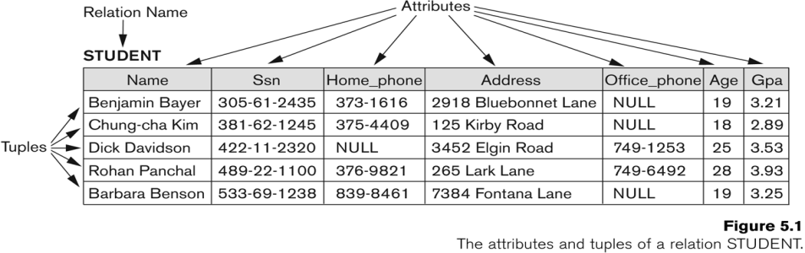
History of Database Systems
Late 1960s and 1970s:
Hard disks allow direct access to data
Network and hierarchical data models in widespread use
Ted Codd defined the relational data model
Won the ACM Turing Award for this work
IBM Research began System R prototype
UC Berkeley began Ingres prototype
High-performance (for the era) transaction processing

Slide 14
History of Database Systems
1980s:
Research on relational prototypes evolved into commercial systems
SQL became industrial standard
Parallel and distributed database systems
Object-oriented database systems
1990s:
Large decision support and data-mining applications
Large multi-terabyte data warehouses
Emergence of Web commerce
2000s:
XML and XQuery standards
Automated database administration
Compiled by Dr. B.Thirumala Rao, Professor, CSE

Slide 15
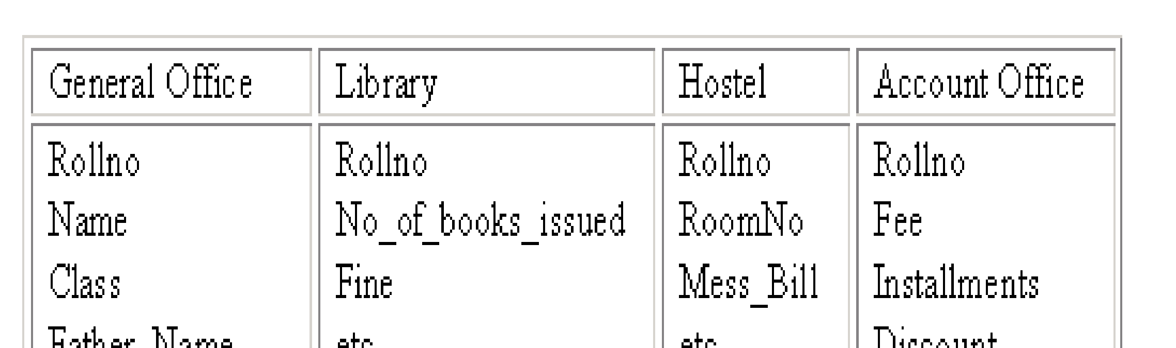
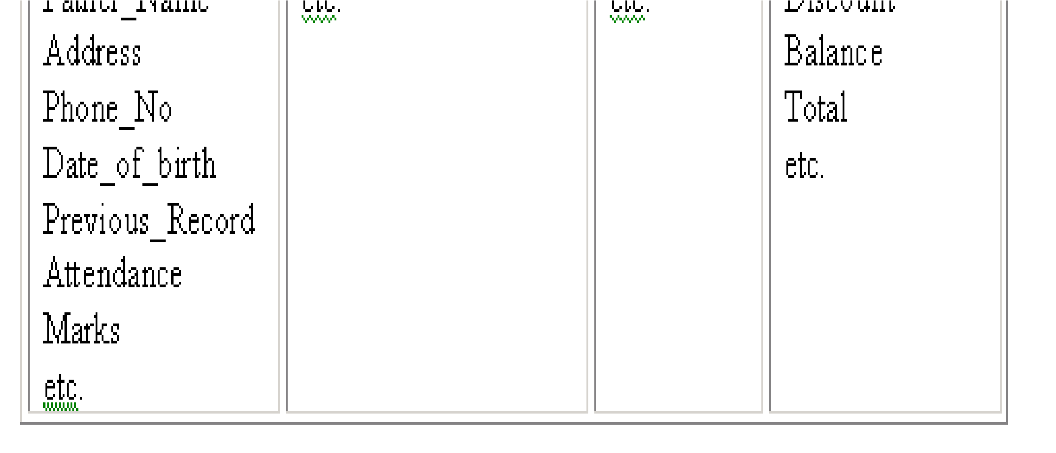
University Database in Database based System

Slide 16
Main Characteristics of the Database Approach
Self-describing nature of a database system.
Insulation between programs and data, and data manipulation.
Support of multiple views of the data.
Sharing of data and multi-user transaction processing

Slide 17
Main Characteristics of the Database Approach
Self-describing nature of a database system
What will be your description of the data stored in the following tables ?
1BM14CS001 | Aditya | 3 | WP
1BM14CS002 | Bharath | 3 | DS
1BM14CS001 | 1000
1BM14CS002 | 1000
1BM14CS001 | O
1BM14CS002 | B

Slide 18
Main Characteristics of the Database Approach
Self-describing nature of a database system.
Student_Details
USN | Name | Sem | Sub
1BM14CS001 | Aditya | 3 | WP
1BM14CS002 | Bharath | 3 | DS
Student_ExamFee_Details
Student_Grade_Details
USN | Amount
1BM14CS001 | 1000
1BM14CS002 | 1000
USN | Grade
1BM14CS001 | O
1BM14CS002 | B

Slide 19
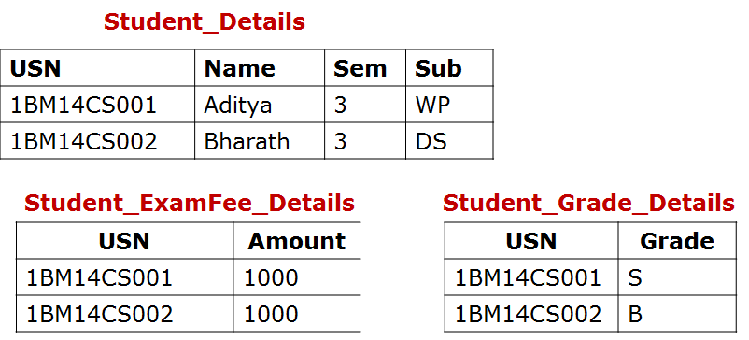
Main Characteristics of the Database Approach
Self-describing nature of a database system.
A DBMS catalog stores meta-data (the description of a particular database e.g. data structures, types, and constraints)
This allows the DBMS software to work with different database applications.
Column_name | Data_Type | Belongs_to
USN | Char(10) | Student_Details
Name | Char(30) | Student_Details
Sem | Integer | Student_Details
Sub | Char(2) | Student_Details
Amount | Float | Student_ExamFee_Details
Grade | Char(1) | Student_Grade_Details

Slide 20
Main Characteristics of the Database Approach
2. Insulation between programs and data, and data manipulation. (program-data independence)
File Approach
student.txt
1BM14CS001 Aditya LA,Java,DBMS,OS,DC
1BM14CS002 Baharth DBMS,OS,DC
fp=fopen("student.txt","r");
while(fscanf(fp,"%s %s %s",USN,name,subjects)!=EOF)
{
printf("USN: %s Name: %s Subjects: %s",USN,name,subjects);
}
What will be the Output of the above program statements ?

Slide 21
Main Characteristics of the Database Approach
2. Insulation between programs and data, and data manipulation.
File Approach
student.txt
Aditya 1BM14CS001 LA,Java,DBMS,OS,DC
Baharth 1BM14CS002 DBMS,OS,DC
fp=fopen("student.txt","r");
while(fscanf(fp,"%s %s %s",USN,name,subjects)!=EOF)
{
printf("USN: %s Name: %s Subjects: %s",USN,name,subjects);
}
What will be the Output of the above program statements ?

Slide 22
Main Characteristics of the Database Approach
2. Insulation between programs and data, and data manipulation.
DBMS Approach
student
USN | Name | Subjects
1BM14CS001 | Aditya | LA, Java, DBMS,OS,DC
1BM14CS002 | Bharath | DBMS, OS, DC
select USN, Name, Subjects from student;
SQL query to retrieve
and display table
information
1BM14CS001 Aditya LA,Java,DBMS,OS,DC
1BM14CS002 Bharath DBMS,OS,DC

Slide 23
Main Characteristics of the Database Approach
2. Insulation between programs and data, and data manipulation.
DBMS Approach
student
Name | USN | Subjects
Aditya | 1BM14CS001 | LA, Java, DBMS,OS,DC
Bharath | 1BM14CS002 | DBMS, OS, DC
select USN, Name, Subjects from student;
SQL query to retrieve
and display table information
1BM14CS001 Aditya LA,Java,DBMS,OS,DC
1BM14CS002 Bharath DBMS,OS,DC

Slide 24
Main Characteristics of the Database Approach
2. Insulation between programs and data, and data manipulation.
Called program-data independence.
Allows changing data structures and storage organization without having to change the DBMS access programs.
A data model is used to hide storage details and present the users with a conceptual view of the database.
Programs refer to the data model constructs rather than data storage details

Slide 25
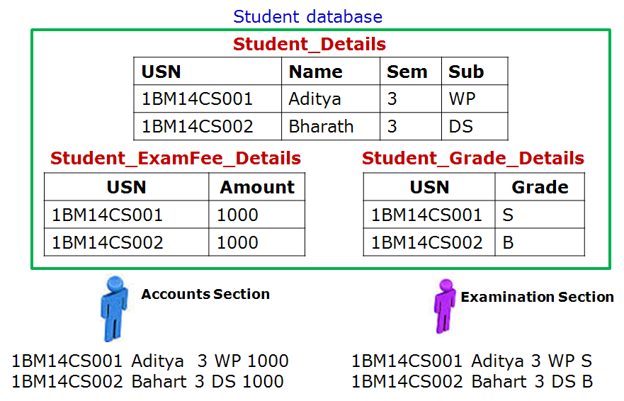
Main Characteristics of the Database Approach
3. Support of multiple views of the data
Each user may see a different view of the database, which describes only the data of interest to that user.

Slide 26
Main Characteristics of the Database Approach
4. Sharing of data and multi-user transaction processing
Train Reservation Database
Source | Destination | Train Name | Start Time | Start Date | Number of Seats Availability
Bangalore | Mysore | Chamundi Express | 18:15 | 14-1-2016 | 2
Train Ticket Booking Software

